Slide 1
Chapter 10: Mass-Storage Systems

Slide 2
Disk Access Time
Seek Time: Time taken by R/W head to reach desired track
Rotational Time: Time taken for one full rotation (360)
Rotational Latency: Time taken to reach to desired sector (Half of Rotational Time).
Transfer Time: Data to be Transfer / Transfer Rate;
Transfer Rate (Data Rate): No. of Heads (No. of Surface) x Capacity of One Track x Number of Rotations in One Second
Capacity of One Track = No. of Sectors in One Track x Amount of Data in One Sector (Sector Size)
RPM -> Rotation per Minute

Slide 3
Disk Access Time
Total Disk Access Time = Seek Time + Rotational Time + Transfer Time + Controller Time + Wait Time (Buffer Time)
These two are considered optional when not mentioned,
Controller Time
Wait Time (Buffer Time)
Time for data to be read by the disk head, i.e., time it takes the sectors of the requested block to rotate under the head
Transfer Rate = Amount of data per track / Time per rotation
Transfer Time = Amount of data to read / Transfer rate

Slide 4
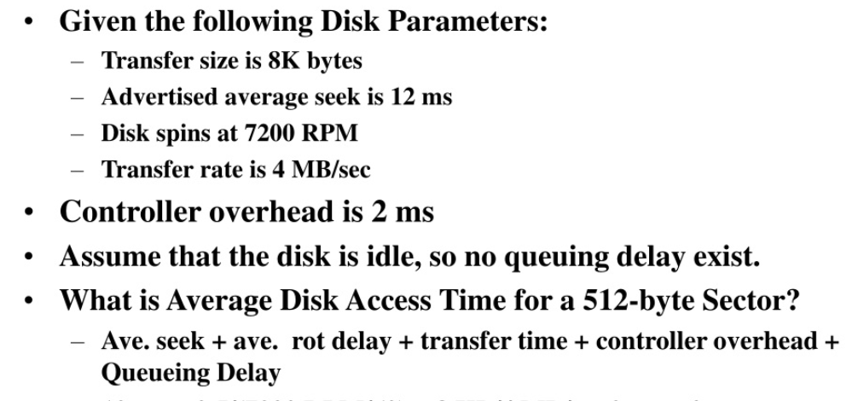
Disk Access Time

Slide 5
Disk Access Time
Given,
Average Seek Time = 12 ms, Controller Overhead = 2 ms , Queuing Delay = 0
Average Rotational Delay = Half of a full rotation
=(½)×(60/7200) sec = 0.00417 sec = 4.17 ms
Transfer Time for 512 bytes:
Transfer rate = 4 MB/sec = 4096 KB/sec and Data = 512 bytes = 0.5 KB
Then, (0.5/4096) sec = 0.000122sec = 0.122ms ≈ 0.12 ms
Corrected Total (with 512-byte transfer time):
12+4.17+0.12+2+0 = 18.29 ms = 18.30 ms

Slide 6
Disk Access Time
Example 2:
The transferring of data is 512 byte, average seek time 4 msec, data transfer rate 40kB, disk rotation 6000 RPM and controller overhead 0.3 msec. Calculate the disk access time.
Average Rotational Delay = Half of a full rotation
6000 RPM means, 6000 rotation in 60 sec
1 “ (60/6000)sec = 0.1 sec = 10 msec
ARD = (½×10) ms = 5 ms
Transfer Time for 512 bytes:
Transfer rate = 40 kB/sec and Data = 512 bytes = 0.5 KB
Then, (0.5/40) sec = 0.0125 sec = 12.5 ms
Disk Access Time for 512 byte data: 4+5+12.5+0.3 = 21.8 ms

Slide 7
Disk Access Time
Example 3:
A hard disk system has 500 tracks where number of sectors/track is 100, number of bytes/sector is 500. The time required to move head from one track to adjacent track is 1 ms. Rotation speed is 600 RPM.
Total Number of movements = (0+499)/2 = 249.5
Seek Time = (249.5*1) ms = 249.5 ms
600 RPM means, 600 rotation in 60 sec
1 “ (60/600)sec = 100 msec
ARD = (½×100) ms = 50 ms
Reading full track = 100 sectors each having 500 bytes
One rotation data transfer time or Reading 500*100 bytes time requires 100 msec
So, for 250 bytes = (100*250/500*100) msec = 0.5 msec
Disk Access Time = Seek Time + Rotational time + Transfer Time
= 249.5 + 50 + 0.5 = 300ms

Slide 8
Magnetic Disk Performance
Access Latency = Average access time = average seek time + average latency
  For fastest disk 3ms + 2ms = 5ms
  For slow disk 9ms + 5.56ms = 14.56ms
Average I/O time = average access time + (amount to transfer / transfer rate) + controller overhead
For example to transfer a 4KB block on a 7200 RPM disk with a 5ms average seek time, 1Gb/sec transfer rate with a .1ms controller overhead =
  5ms + 4.17ms + 0.1ms + transfer time =
  Transfer time = 4KB / 1Gb/s * 8Gb / GB * 1GB / 1024² KB = 32 / (1024²) = 0.031 ms
  Average I/O time for 4KB block = 9.27ms + .031ms = 9.301ms

Slide 9
Disk Scheduling Algorithms
FCFS
SSTF
SCAN
LOOK
C-SCAN
C_LOOK

Slide 10
Selecting a Disk-Scheduling Algorithm
SSTF is common and has a natural appeal
SCAN and C-SCAN perform better for systems that place a heavy load on the disk
  Less starvation
Performance depends on the number and types of requests
The disk-scheduling algorithm should be written as a separate module of the operating system, allowing it to be replaced with a different algorithm if necessary
Either SSTF or LOOK is a reasonable choice for the default algorithm
What about rotational latency?
  Difficult for OS to calculate

Slide 11
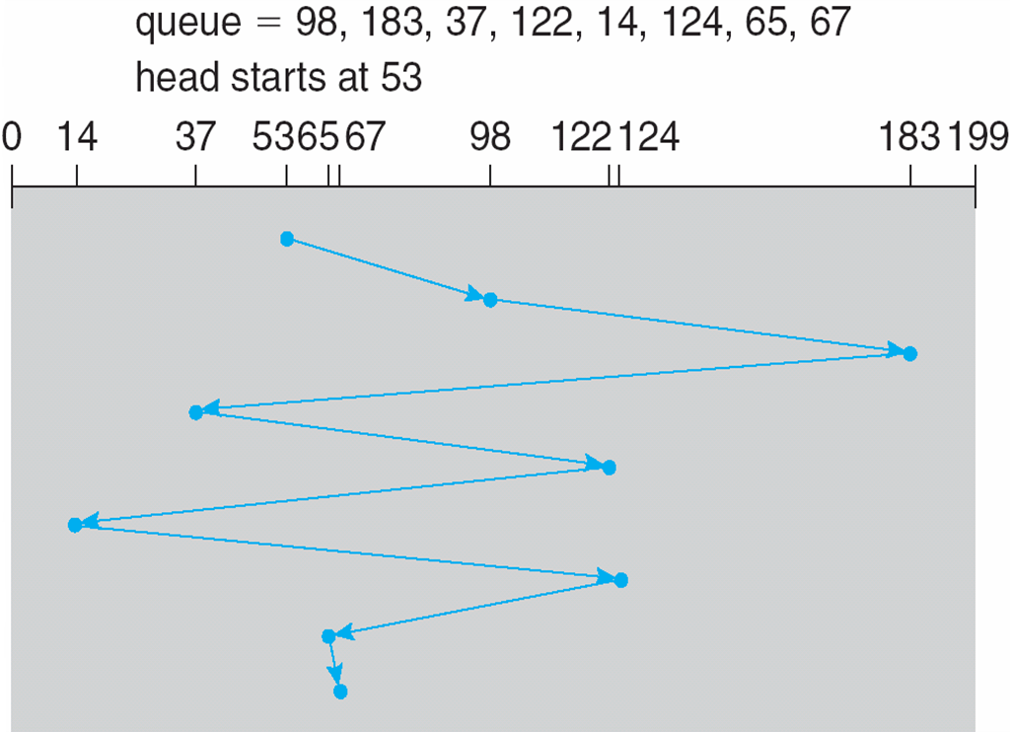
FCFS: First Come First Serve
Illustration shows total head movement of 640 cylinders

Slide 12
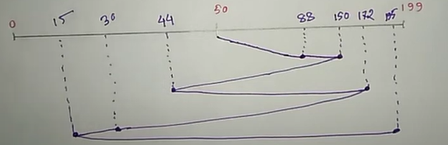
FCFS: First Come First Serve
A disk contains 200 tracks (0-199). The request queue contains track no 88, 150, 44, 172, 30, 15, 195. Current position of Read/Write head is at track 50. Calculate the total number of track movement.

Slide 13
FCFS: First Come First Serve
Method 1:
Total number of track movement
= (150-50)+(150-44)+(172-44)+(172-15)+(195-15)
= 671
Method 2:
Total number of track movement
= (88-50)+(150-88)+(150-44)+(172-44)+(172-30)+(30-15)
= 671

Slide 14
SSTF: Shortest Seek Time First
First selects the request with the minimum seek time from the current head position
Seek time depends on number of movement. If the movement from source is less then seek will be also similar.
SSTF scheduling is a form of SJF scheduling; may cause starvation of some requests
Illustration shows total head movement of 236 cylinders

Slide 15
SSTF: Shortest Seek Time First
A disk contains 200 tracks (0-199). The request queue contains track no 88, 150, 44, 172, 30, 15, 195. Current position of Read/Write head is at track 50. Calculate the total number of track movement.
Nearest Track Calculation:
50-44=6 50-30=10
44-30=14 44-14=29
30-15=15 — — —
If the difference is same then apply for both and take the one with shortest seek time.

Slide 16

SSTF: Shortest Seek Time First
Method 1:
Total number of track movement
= (50-15)+(195-15)
= 215

Slide 17
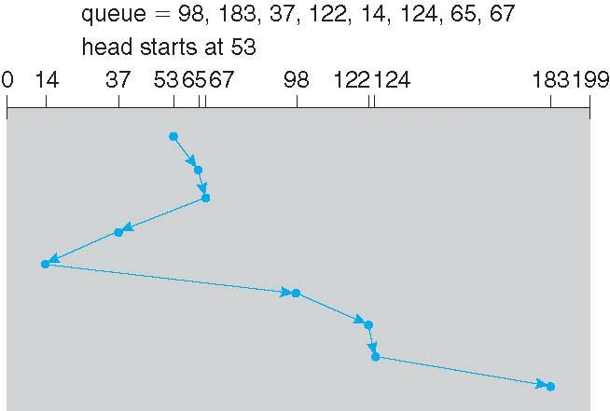
SSTF: Shortest Seek Time First

Slide 18
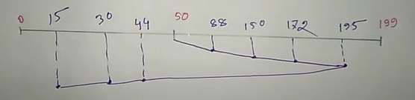
LOOK
LOOK works in a particular direction
A disk contains 200 tracks (0-199). The request queue contains track no 88, 150, 44, 172, 30, 15, 195. Current position of Read/Write head is at track 50. Calculate the total number of track movement (Increasing order).

Slide 19
LOOK
Method 1:
Total number of track movement
= (195-50)+(195-15)
= 325

Slide 20
C-LOOK
LOOK a version of SCAN, C-LOOK a version of C-SCAN
Arm only goes as far as the last request in each direction, then reverses direction immediately, without first going all the way to the end of the disk
Total number of cylinders?

Slide 21
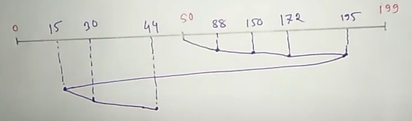
C-LOOK
A disk contains 200 tracks (0-199). The request queue contains track no 88, 150, 44, 172, 30, 15, 195. Current position of Read/Write head is at track 50. Calculate the total number of track movement (Increasing order).

Slide 22
C-LOOK
Method 1:
Total number of track movement
= (195-50)+(195-15)+(44-15)
= 354

Slide 23
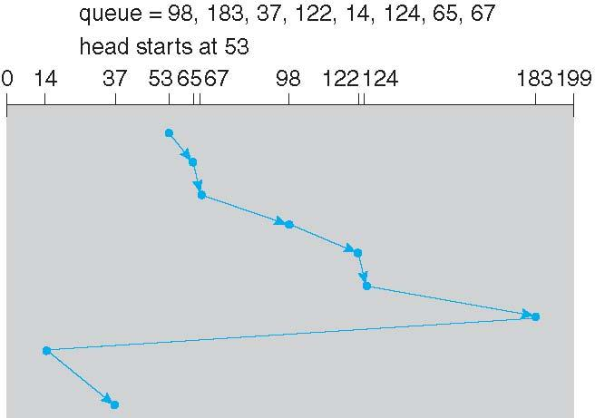
C-LOOK

Slide 24
SCAN
The disk arm starts at one end of the disk, and moves toward the other end, servicing requests until it gets to the other end of the disk, where the head movement is reversed and servicing continues.
SCAN algorithm Sometimes called the elevator algorithm
Illustration shows total head movement of 208 cylinders
But note that if requests are uniformly dense, largest density at other end of disk and those wait the longest

Slide 25
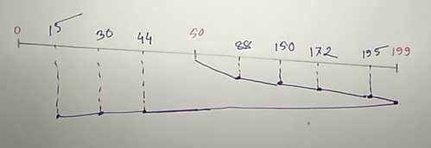
SCAN
A disk contains 200 tracks (0-199). The request queue contains track no 88, 150, 44, 172, 30, 15, 195. Current position of Read/Write head is at track 50. Calculate the total number of track movement (Increasing order).

Slide 26
SCAN
Method 1:
Total number of track movement
= (199-50)+(199-15)
= 354

Slide 27
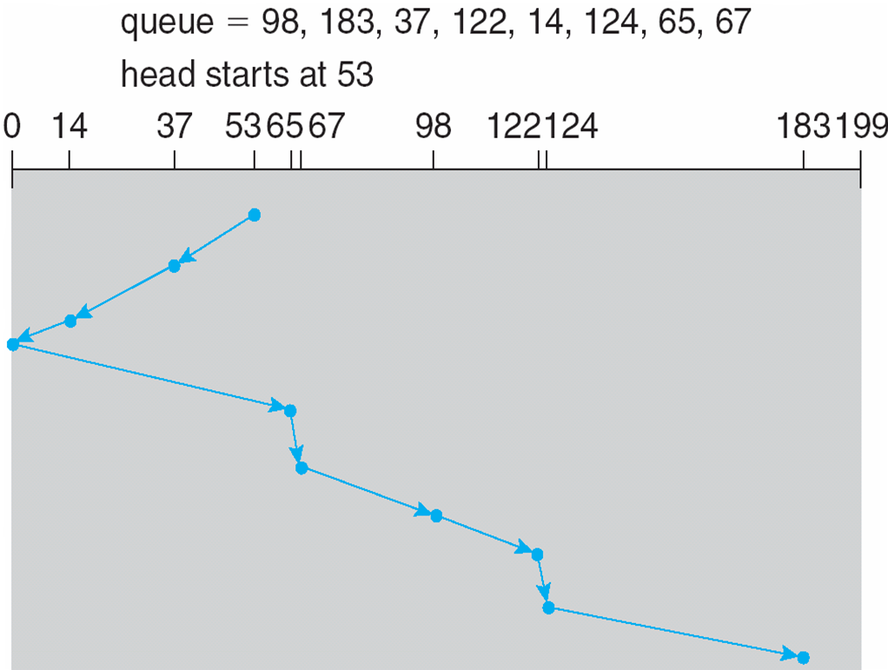
SCAN (Cont.)

Slide 28
C-SCAN
Provides a more uniform wait time than SCAN
The head moves from one end of the disk to the other, servicing requests as it goes
  When it reaches the other end, however, it immediately returns to the beginning of the disk, without servicing any requests on the return trip
Treats the cylinders as a circular list that wraps around from the last cylinder to the first one
Total number of cylinders?

Slide 29
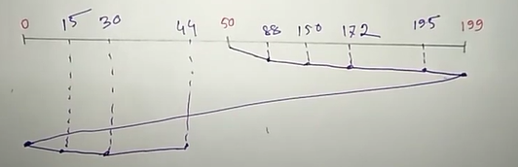
C-SCAN
A disk contains 200 tracks (0-199). The request queue contains track no 88, 150, 44, 172, 30, 15, 195. Current position of Read/Write head is at track 50. Calculate the total number of track movement (Increasing order).

Slide 30
C-SCAN
Method 1:
Total number of track movement
= (199-50)+(199-0)+(44-0)
= 392

Slide 31
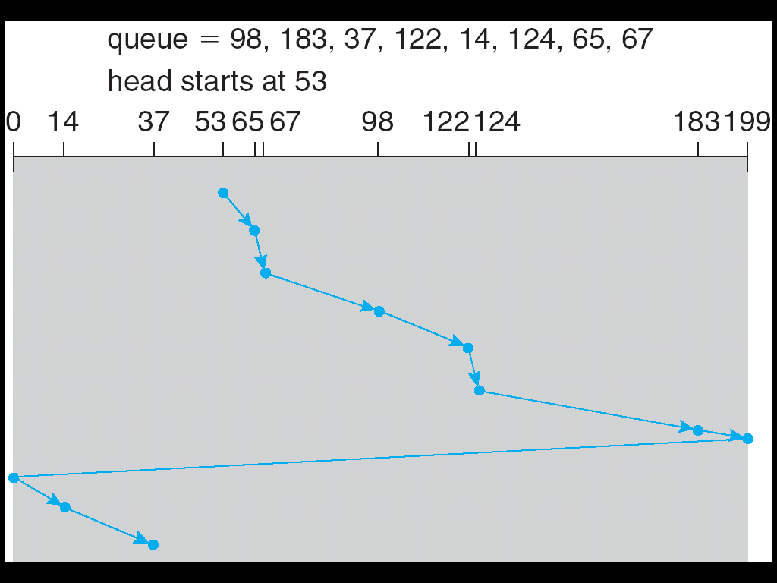
C-SCAN (Cont.)

Slide 32
Notes
Current R/W head is at 50 but previous request was at 75
This denotes Decreasing Order 75 -> 50
Current R/W head is at 50 but previous request was at 32
This denotes Increasing Order 32 -> 50
These orders are for SCAN, LOOK, C-SCAN, C-LOOK
If R/W head taked 1ns to move from one track to another then calculator the total time taken.
Ans: Total no of track movement * Time to move from one track to
another

Slide 33
End of Chapter 12

